Slide 1
ANNAMALAI UNIVERSITY DEPT OF COMMERCE
BUSINESS ENVIRONMENT
WELCOME PARTICIPANTS

Slide 2
A PRESENTATION BY PROF. D. ILANGOVAN, HD COMMERCE, AU
EMERGING TRENDS
IN SELECTED
INDIAN BUSINESS SECTORS TODAY

Slide 3
INDIAN ECONOMIC GROWTH-A PROJECTION
Country | Expected GDP Growth (IN PERCENTAGE)
 | 2018 | 2019 | 2020 | 2021 | 2022 | 2023
India | 7.3 | 7.4 | 7.7 | 7.7 | 7.7 | 7.8
China | 6.6 | 6.2 | 6.2 | 6.0 | 5.8 | 5.6
USA | 2.9 | 2.5 | 1.8 | 1.7 | 1.5 | 1.4
Europ-ean Union | 2.2 | 2.0 | 1.8 | 1.7 | 1.7 | 1.6

Slide 4
GLOBAL GROWTH FORECAST FOR 2018,2019

Slide 5
Economic Trends in General
While extreme poverty has declined notably, progress in alleviating poverty at higher income levels has been slower, with nearly a quarter of the world’s population still living with less than $3.20 per day, the World bank said
It also said poverty rates remained the highest among low-income countries, but the majority of extreme poor currently reside in large lower-middle-income countries, including India
India would continue to remain the fastest-growing large economy in the world as the immediate competitor i.e., China was projected to grow 6.5 per cent in 2018 and 6.2 per cent in 2019.

Slide 6
INDIAN MANUFACTURING SECTOR,2019
The Indian manufacturing sector has evolved drastically in the past few years and has become one of the high growth sectors of India. Initiatives such as Make in India and implementation of good and service tax (GST) have been the boosters in the growth of this industry.
By 2020, India is expected to become the 5th largest manufactory country. Such a tremendous growth has made a majority of foreign nations positive and confident of Indian manufacturing industry, by the International Monetary Fund (IMF) and World Bank Group.
Under the Make in India initiative, the Government of India aims to increase the share of the manufacturing sector to the gross domestic product (GDP) to 25 per cent by 2022, from 16 per cent, and to create 100 million new jobs by 2022.
Business conditions in the Indian manufacturing sector continue to remain positive.

Slide 7
KEY INDICATORS FOR 2019
Indian manufacturing sector is expected to reach US$ 1 trillion by 2025 as numerous foreign investors can see huge growth potential in this nation.
Major focus will be on enlarging export market and strengthening domestic demand.
Achieve more than 7% growth in GDP.
Easier regulatory process with an opening of more foreign direct investment (FDI) to 51% from the current 49% for large investment and better employment.
Reduced waiting period at export gateways for capacity augmentation
Reduced procedural delays at with digital platforms and simplified processes
Improved safety procedures and manufacturing standards harmonization to ensure compliance with global standards
Policy creations that focus on quality and cost to make India excel over other nations
Evaluation of existing schemes to remove export and manufacturing constraints

Slide 8
MAJOR INITIATIVES FOR INDIAN MANUFACTURING SECTOR
National Policy on Electronics (NPE): To create an electronic manufacturing industry of US$ 400 billion by 2025.
Exemption of custom duty on 35 machine parts to increase mobile handset production
Phased manufacturing program (PMP): To push domestic manufacturing of mobile handsets
Hike in GST exemption from Rs 20 lakh to Rs40 lakh
Reduction of the income tax rate to 25% for companies with a turnover of Rs 250 crore and less
Increased export incentives by 2% for the MSME sector
Strategic Partnership model for private companies to tie up with foreign companies when manufacturing armored vehicles, jets, submarines, etc.
Modified Special Incentive Package Scheme (MSIPS): To promote large-scale manufacturing. This provides a 20% subsidy on capital investments in special economic zones (SEZs) and 25% on non-SEZz.
Also, the Government organizing various skill programs to increase employment especially in the poor and underdeveloped areas of the nation.

Slide 9
TRENDS IN NPAs and INFLATION
Showing concerns over non-performing assets (NPAs), the World Bank said bad debts in South Asia were still high despite recent measures.“Especially, public sector banks in India, which represent roughly 70 per cent of the banking sector assets, still report low profitability and high NPAs,” it said.
“Inflation is projected to rise somewhat above the midpoint of the Reserve Bank of India’s target range of 2 to 6 per cent, mainly owing to energy and food prices”

Slide 10
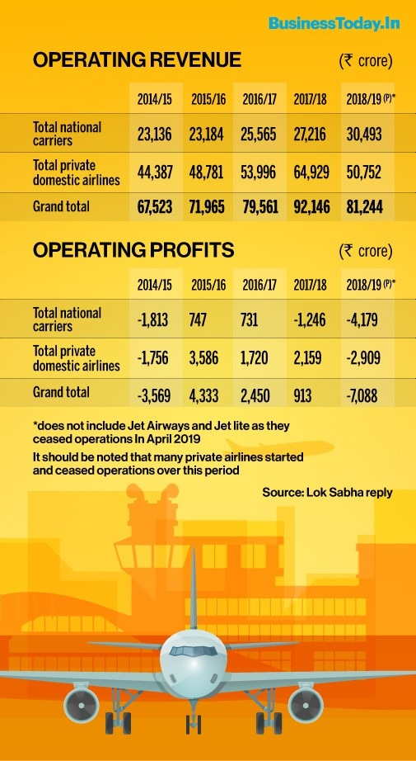
Indian Aviation Sector

Slide 11
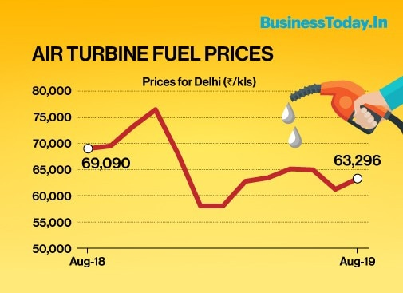
Aviation Sector Con..td.

Slide 12
TRENDS IN INDIAN SERVICE SECTOR
Service sector contributes one-third of global GVA(Gross value added is the output of less the intermediate consumption, which is the difference between gross output and net output), half of global employment, one-fifth of global trade and around half of global FDI flows.
In 2014 India's service sector grew at 10.3 per cent was noticeably higher than that of China at 8.0 per cent.
Sector | India | USA | China
Agriculture and Allied | 15.4% (53%) | 8% (2%) | 7% (26%)
Manufacturing and Industry | 23% (22%) | 12% (19%) | 40% (28%)
Services – Mainly IT sec. | 61.5% (25%) | 80% (79%) | 52% (46%)

Slide 13
Comparison with Major Economies

Slide 14
Investment in Indian Agricultural Sector

Slide 15
Challenges Before Indian Agricultural Sector
Adverse climatic conditions,
Irregular Funding for pre and post harvest activities,
Uneven distribution of farm lands among the interest groups,
Going Digital,
Empowering the Farmer Producer Organisations,
Enhancing Water Management Efficiently and
Evolving Startup Ecosystem
In 2018, the GVA for the agricultural sector was INR 17.67 trillion, says independent research. The research also adds that the sector is all set to grow at an approximate rate of 2% year-on-year.

Slide 16
Challenges……………cont…d.
Apart from all these, solid strides like expanding the insurance net, effective claim management, controlling distress sale and the oversupply of agricultural commodities during the peak season and efficaciously mitigate the agricultural losses in the near future. The contribution of government organizations, industry players, and budding startups can together transfigure the face of Indian agriculture to its best.
Technology is yet another deciding factor for all.

Slide 17
THANK YOU ALL
QUESTIONS FOR DISCUSSION WELCOME

